Slide 1


HEP Weekly Report
George Bakas

Slide 2
Weekly Report
Top Tagger:
New WP’s for 2017 and 2018
DCS:
ConfDbChecks in CMSfwInstallUtils
tool that allows checks between db and project.
Testing
fwInstallationUtils
Further improvements to the tool
ArdEnvino
Live measurements at the lab
TOP-18-013
Closure tests
Efficiency, Acceptance for new variables for parton and particle

Slide 3
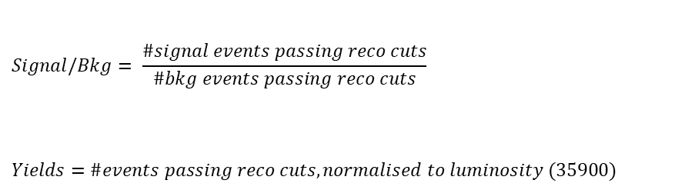
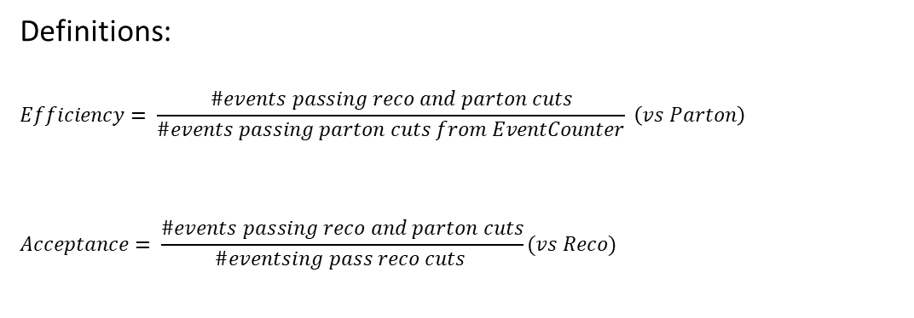
Overview
Efficiencies and Acceptance for mTT and jetPt variables
Selection:
Jet Matching
Parton cuts:
partonPt[0],[1] > 400
|partonEta[0],[1]| < 2.4
mTTbarParton > 1000
Reco cuts:
nJets > 1
nLeptons = 0
mJJ > 1000
jetPt[0],[1] > 400
|jetEta[0],[1]| < 2.4
bTagging (Medium WP deepCSV)
Tagger cut (top Tagger)
JetMassSoftDrop > 120 and < 220
Definitions:
$$Efficiency= \frac{\#events passing reco and parton cuts}{\#events passing parton cuts from EventCounter} \left(vs Parton\right)$$
$$Acceptance= \frac{\#events passing reco and parton cuts}{\#eventsing pass reco cuts }(vs Reco)$$
$$Signal/Bkg= \frac{\#signal events passing reco cuts}{\#bkg events passing reco cuts}$$
$$Yields=\#events passing reco cuts, normalised to luminosity (35900)$$

Slide 4
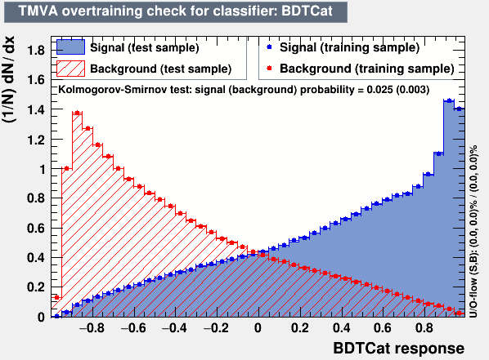
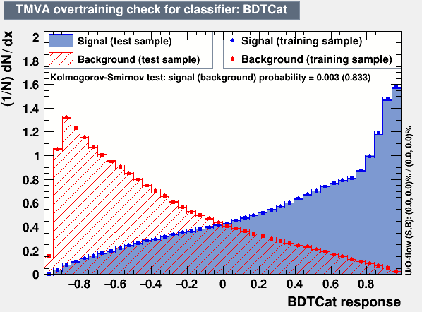
Training Outputs
2017
2018

Slide 5
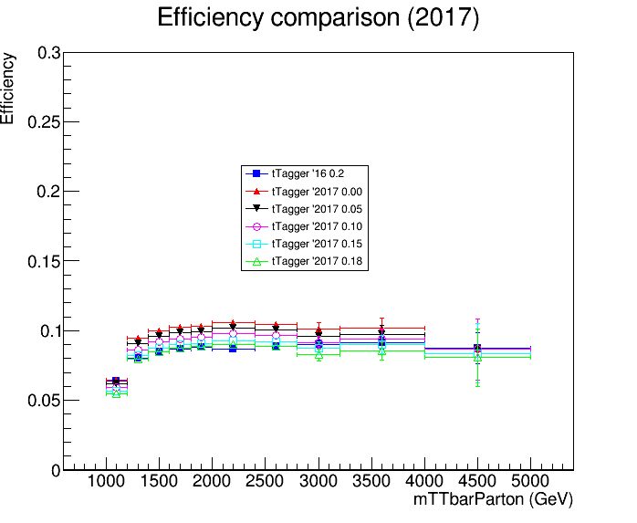
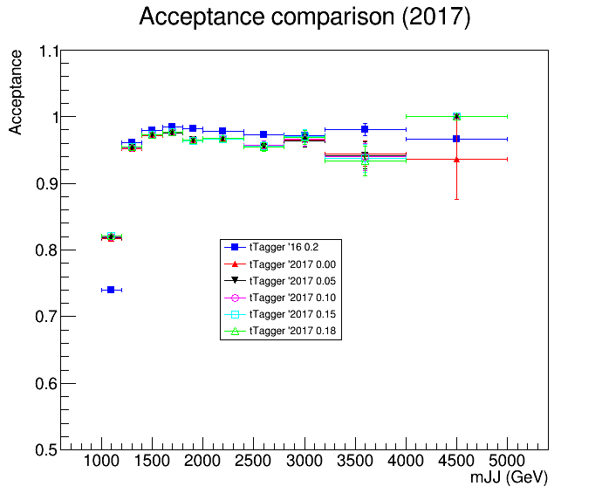
Acceptance and Efficiency 2016 vs 2017 (no btagging requirement)

Slide 6
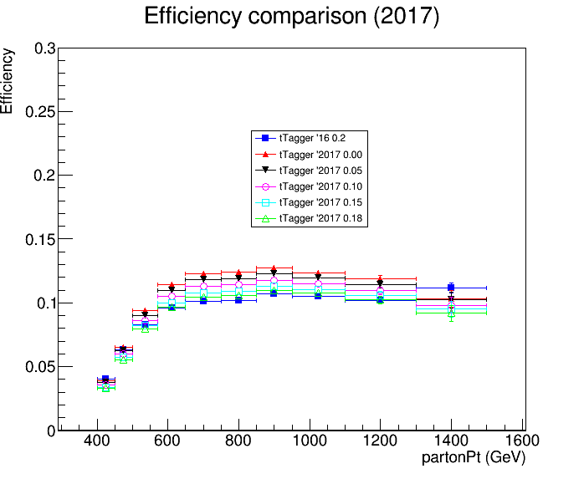
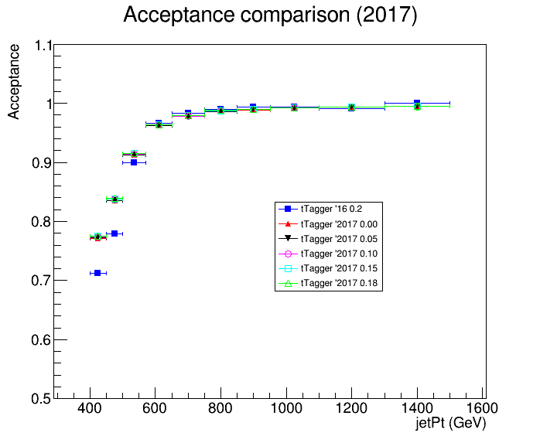
Acceptance and Efficiency 2016 vs 2017 (no btagging requirement)

Slide 7
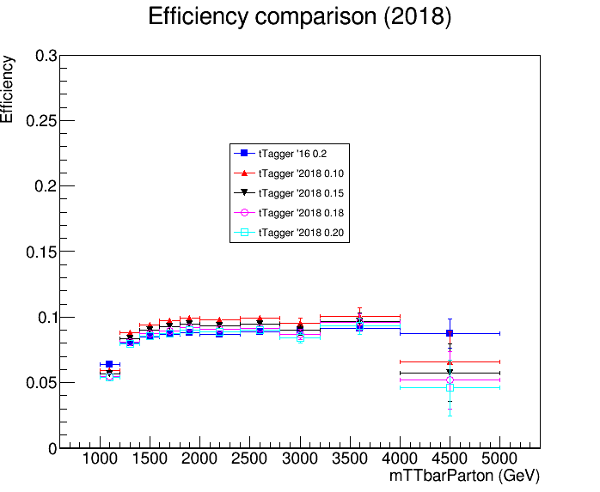
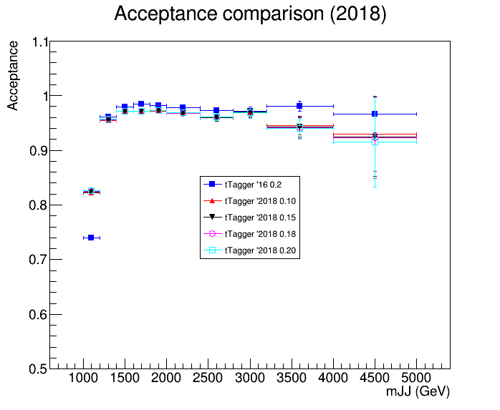
Acceptance and Efficiency 2016 vs 2018 (no btagging requirement)

Slide 8
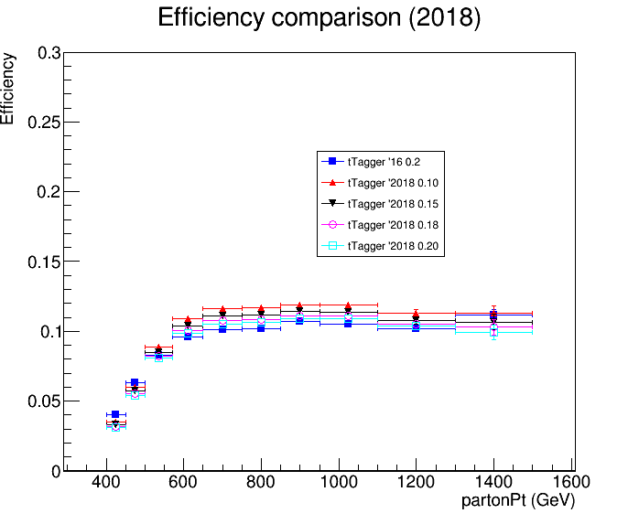
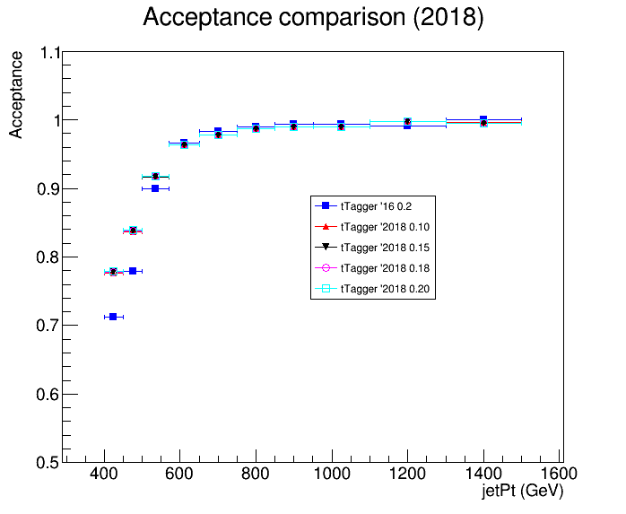
Acceptance and Efficiency 2016 vs 2018 (no btagging requirement)

Slide 9
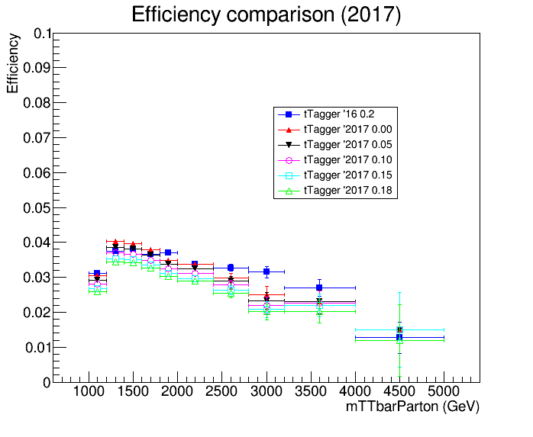
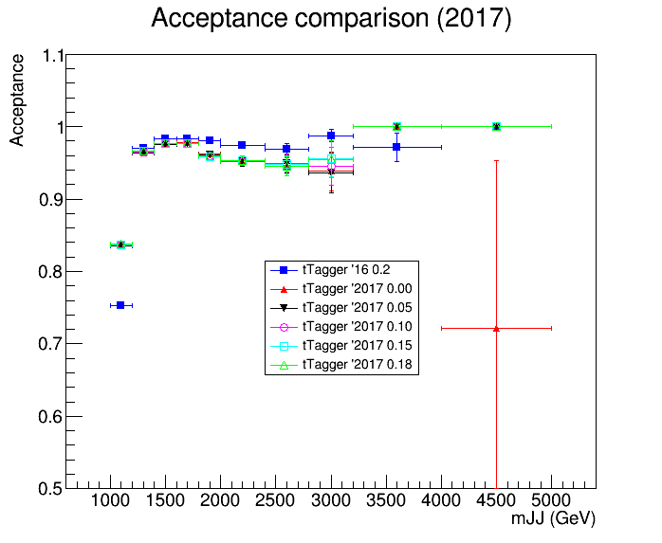
Acceptance and Efficiency 2016 vs 2017 (with btagging)

Slide 10
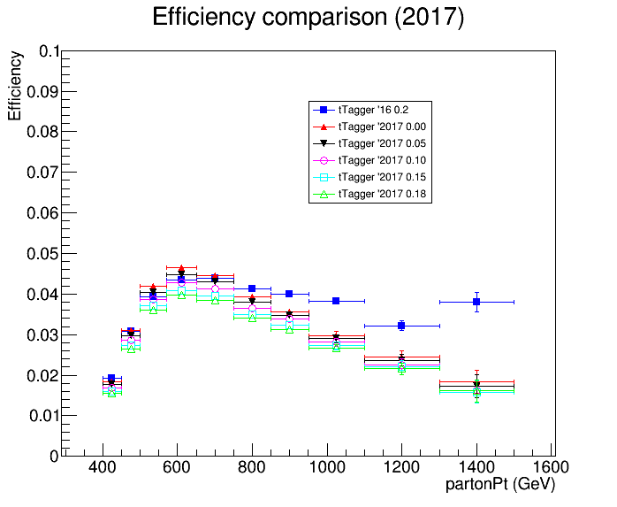
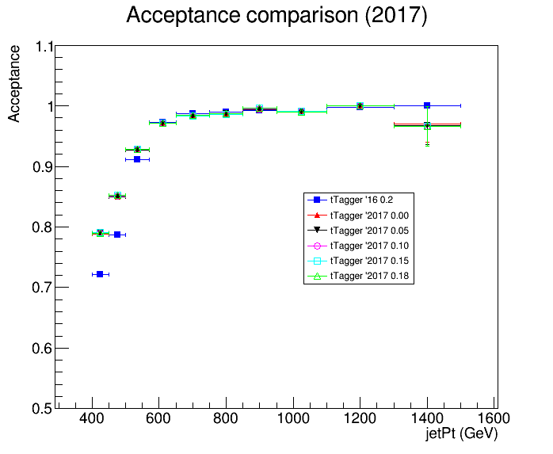
Acceptance and Efficiency 2016 vs 2017 (with btagging)

Slide 11
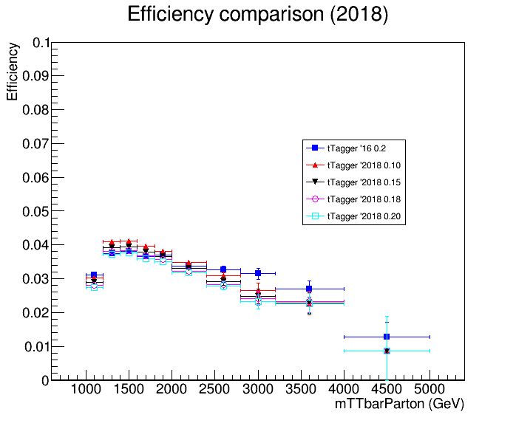
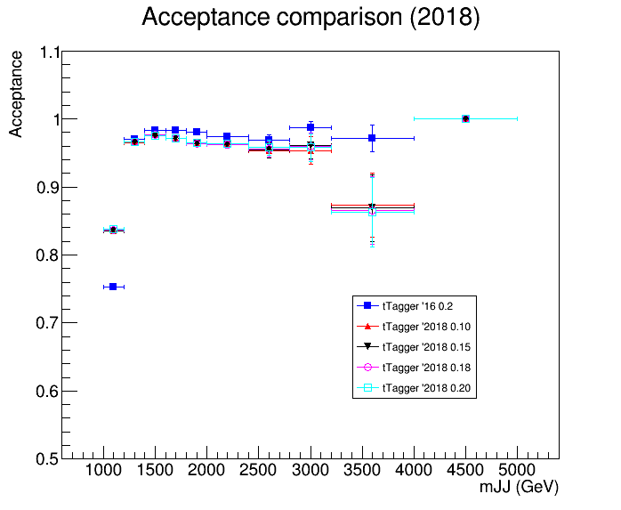
Acceptance and Efficiency 2016 vs 2018 (with btagging)

Slide 12
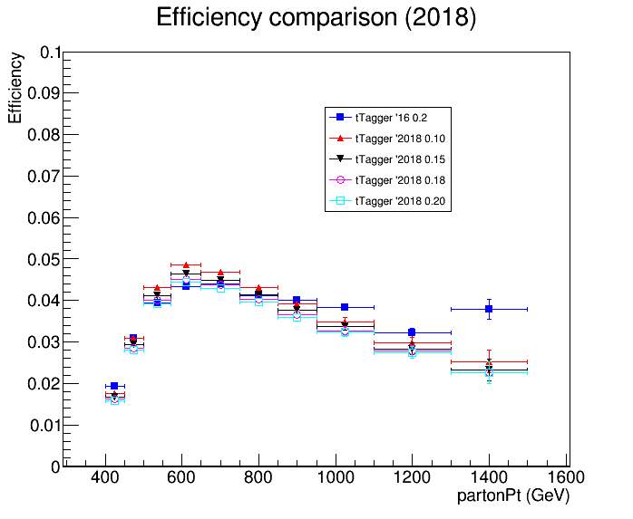
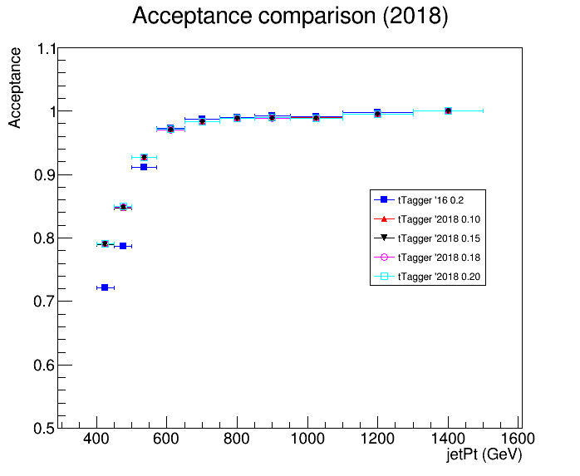
Acceptance and Efficiency 2016 vs 2018 (with btagging)

Slide 13
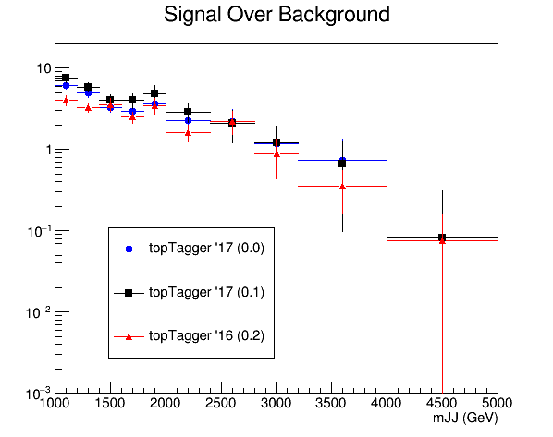
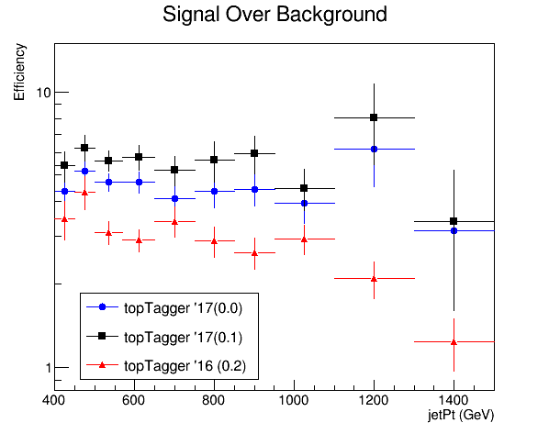
Signal over Bkg 2016 vs 2017

Slide 14
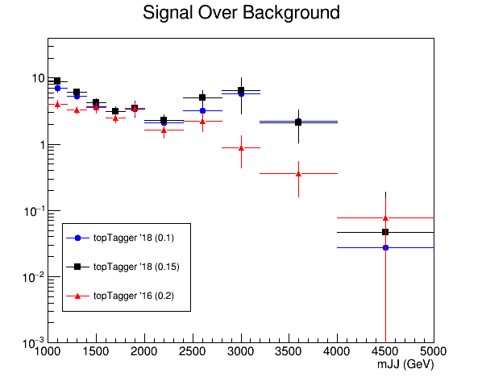
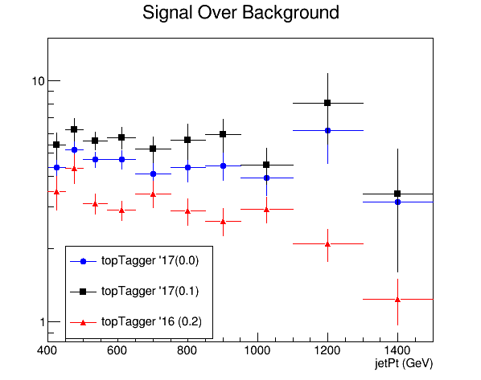
Signal over Bkg 2016 vs 2018

Slide 15
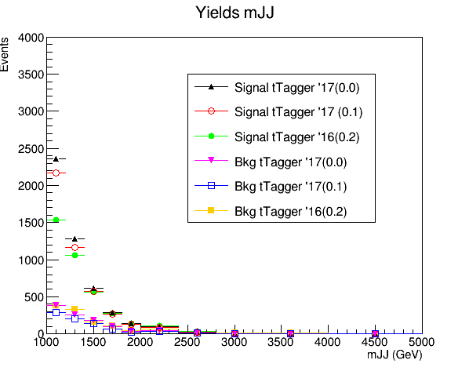
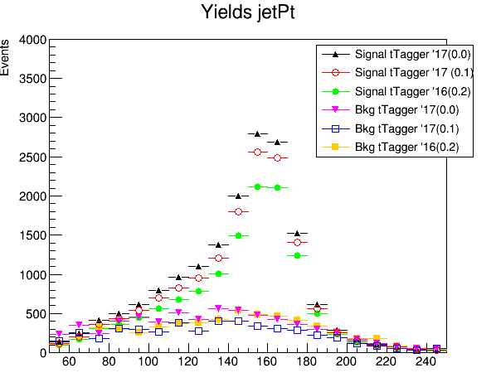
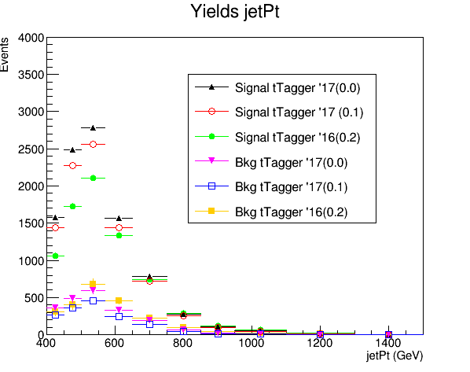
Expected yields 2016 vs 2017
jetMassSoftDrop (GeV)

Slide 16
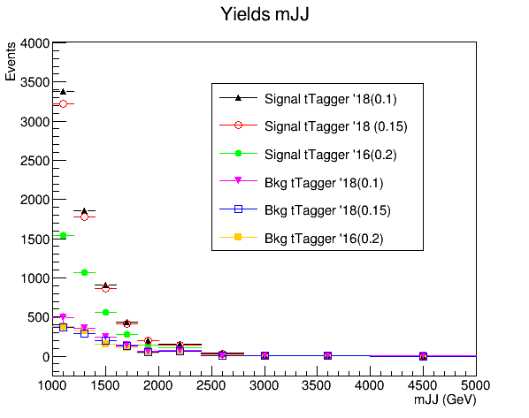
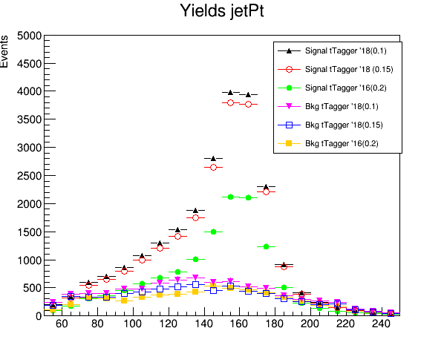
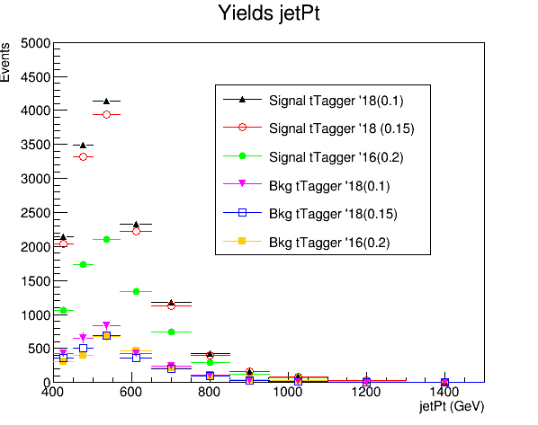
Expected yields 2016 vs 2018
jetMassSoftDrop (GeV)

